Slide 1
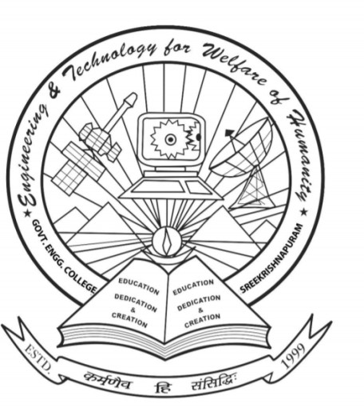
AURA: AUTOMATED USER RECOGNITION & ASSISTANCE
Government Engineering College Palakkad Sreekrishnapuram
TEAM MEMBERS
AL THANZEERA BASHEER [PKD22IT013]
APARNA SABU [PKD22IT020]
FATHIMA A [PKD22IT030]
JEMSHEENA M [PKD22IT036]
PROJECT GUIDE: Dr. SILPA SANGEETH L R

Slide 2
CONTENTS
INTRODUCTION
LITERATURE SURVEY
PROBLEM STATEMENT
OBJECTIVES
FLOWCHART
WORKING DIAGRAMS
SOFTWARE AND HARDWARE COMPONENTS
INPUT MODULE
PROCESSING MODULE
OUTPUT MODULE
CIRCUIT DIAGRAM
IMPLEMENTATION
RESULTS
GANTT CHART
TASK ALLOCATION
CONCLUSION
REFERENCES

Slide 3
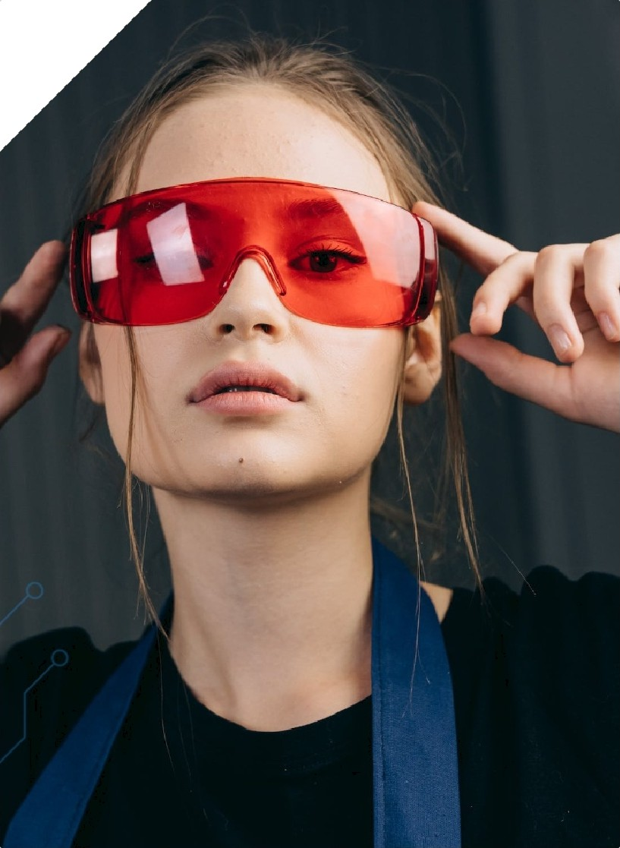




INTRODUCTION
01
02
CHALLENGES FACED BY THE VISUALLY
IMPAIRED
Visually impaired individuals struggle to understand their surroundings, impacting their daily lives.
INTRODUCTION OF SMART GLASSES
Our project introduces smart glasses designed with Al-powered object and scene recognition technology.
FUNCTIONALITY OF THE GLASSES
These glasses narrate surroundings in multiple languages through Bluetooth earphones, enhancing accessibility.
AFFORDABILITY AND USER-
FRIENDLINESS
We emphasize creating an affordable and user-friendly solution to assist visually impaired people.

Slide 4
LITERATURE SURVEY 1
Multi-Object Recognition System for the Blind
1. Introduction: - Blind individuals face risks due to limited obstacle detection and faulty aids.
2. Objective: - Develop a system for safe navigation using real-time video and sensors. 3. System Overview: - Raspberry Pi-based with camera, ultrasonic sensor, and voice guidance. - Detects signals, bollards, tactile paving, and obstacles. 4. Key Results: - Pedestrian signal accuracy: 89% (day), 64% (night). - Bollard recognition: 92.4%. - Successfully tested obstacle avoidance. 5. Conclusion: - Improves mobility for the blind. - Future scope: Infrared, lidar, and more object detection.

Slide 5
LITERATURE SURVEY 2
Deep Learning for Obstacle Classification
1.Objective: -
Extend the ENVISION system to classify obstacles and provide detailed environmental awareness to visually impaired users.
2.Proposed Method: -
Uses deep learning techniques.
Operates on partial visual information and handles noise.
3.Results: -
Achieved 98% accuracy in offline testing and 90.2% in real-world tests. -
Demonstrated high precision, recall, and reliability in diverse conditions.
4.Conclusion: -
Efficient and robust solution for real-time obstacle classification.
Future plans include integrating face recognition and obstacle velocity detection.
Notes:
points

Slide 6
LITERATURE SURVEY 3
Wearable Assistive Devices for the Visually Impaired
Objective: - Develop a wearable device for navigation and object recognition using RGB-D camera and smartphone.
Features: -
Navigation via ground segmentation and path planning.
- Object detection for identifying categories, locations, and orientations.
3. Results: - Tested indoors and outdoors, ensuring user safety and enhanced mobility.
4. Future Scope: - Adding tactile feedback and staircase detection for improved functionality.
5. Conclusion: Demonstrates effective integration of navigation and recognition for visually impaired users.

Slide 7
LITERATURE SURVEY 4
Efficient Multi-Object Detection and Smart Navigation Using AI for Visually Impaired People
Objective:
Efficient Multi-Object Detection and Smart Navigation Using AI for Visually Impaired People ​
2.Key features
Object Detection: Utilized YOLO-v3 for real-time, accurate recognition.​
Dataset:​Custom dataset from visually impaired institutions.​
Obstacle Navigation: Distance sensors detect objects and differentiate obstacles.
3. Impacts:
Enhanced mobility and independence for visually impaired individuals.​
Low-cost and portable assistive solution.​
4. Conclusion:
A low-cost, standalone device enabling independence and safety for visually impaired individuals.

Slide 8
"Visually impaired individuals face challenges in recognizing objects and understanding their environment, which our smart glasses aim to solve through real-time object detection and multilingual narration."
PROBLEM STATEMENT

Slide 9
OBJECTIVES
To develop smart glass to assist visually impaired individuals.
Implement real-time object detection using ESP32-CAM.
Provide GPS module-based navigation with voice guidance.
Provide multilingual narration and voice command recognition for accessibility and user convenience.

Slide 10
FEATURES
Hands-Free, Voice-Controlled Operation.
Multilingual Support for Seamless Communication.
Real-Time Object Detection Using ESP32-CAM.
Face Recognition for Identifying People.
Currency Detection for Financial Transactions.
Cloud Connectivity via Firebase.
Emergency Navigation Assistance

Slide 11
FLOWCHART
Data collection
ESP32-CAM captures surroundings and objects
Dataset Labeling
(bounding boxes)(labelling)
Data preprocessing
Resize, grayscale, normalize( OpenCV, NumPy)
Firebase
Store the labels in firebase
Model Training
Fine-tune YOLOv4( PyTorch,YOLOv5)
Flutter app
Real time inference
Run inference on live data(YOLOv5, OpenCV)
User Interaction
Receive voice commands (SpeechRecognition)
Uses Google Maps API for route guidance
navigation
Navigation/detection
detection
Converts detected objects into audio output using TTS
Fig1.1.Working of smart glass

Slide 12
BLOCK DIAGRAM
ESP32
(Image Capture &
processing )
Li-on Battery+Charging module+Gps module
Mobile App
Power supply
Audio signal
transmission
Fig1.2 Block diagram

Slide 13
ARCHITECTURE DIAGRAM
Detect/
navigation
Language Selection
Voice input
detect
Voice-input
conversions
Image capture
navigation
Speech-to-text (STT)
Pre-processing
(OpenCV)
Emergency
audio call
emergency
Emergency/navigate
Firebase
Object detection
(YOLOV5)
navigate
Navigation through google map
Text-to-speech(TTs) Conversion
Multilingual Text
Audio Output
Fig 1.3 Architecture diagram

Slide 14
INTERACTION DIAGRAM
User
ESP32
ML Model
Firebase
Mobile App
Maps/
Emergency
Switch on
Start the process
Process image
If object is detected
Yes
Try again,capture image
Detected objects
Store in firebase
No
Detection
Navigation/
detection
Navigation
Select the preferred language
Multilingual tts
Stop Process
Switch off
Fig1.4 Interaction diagram

Slide 15
SOFTWARE AND HARDWARE COMPONENTS
Hardware Components
ESP32-CAM : Captures real-time images for object detection
and face recognition.
ESP32 Dev Board: Module for programming ESP32 cam.
GPS Module : Provides real-time location tracking for navigation.
Li-ion Battery + Booster(J5019) with charger:
Supplies portable power, ensures stable voltage regulation.
On/Off Button: Allows manual activation and deactivation of the
power supply.

Slide 16
SOFTWARE AND HARDWARE COMPONENTS
Software components
Open CV & YOLOv5 : Object detection and face recognition.
Firebase: Cloud-based database for storing real-time object and location data.
Text-to-Speech (TTS):Converts detected object labels into voice output.
Speech-to-Text(STT): Converts user speech into text for voice command processing.
Flutter : Mobile app development framework for user interaction.
Twillio API: For emergency SMS services

Slide 17
INPUT MODULE
Mobile App
The user gives a voice commands.
ESP32-CAM
Process real-time images of the surrounding.
GPS Module
Retrieves real-time location coordinates.
Speech-to-Text(STT) API
Processes user voice commands.

Slide 18
PROCESSING MODULE
Images and voice commands are processed.
Images are processed by OpenCV & YOLOv5 for object detection and face recognition.
Detected object labels and location coordinates are stored in firebase.
Text-to-Speech(TTS) converts object labels into audio output.

Slide 19
OUTPUT MODULE
Detected object data are sent to the mobile app.
Mobile app retrieves detected object data from firebase and provides voice feedback.
If the user says “Navigate“, the app retrieves the stored home location and opens Google Maps with voice navigation.
Emergency assistance is activated through an automated call and location message when “Emergency" is recognized.

Slide 20
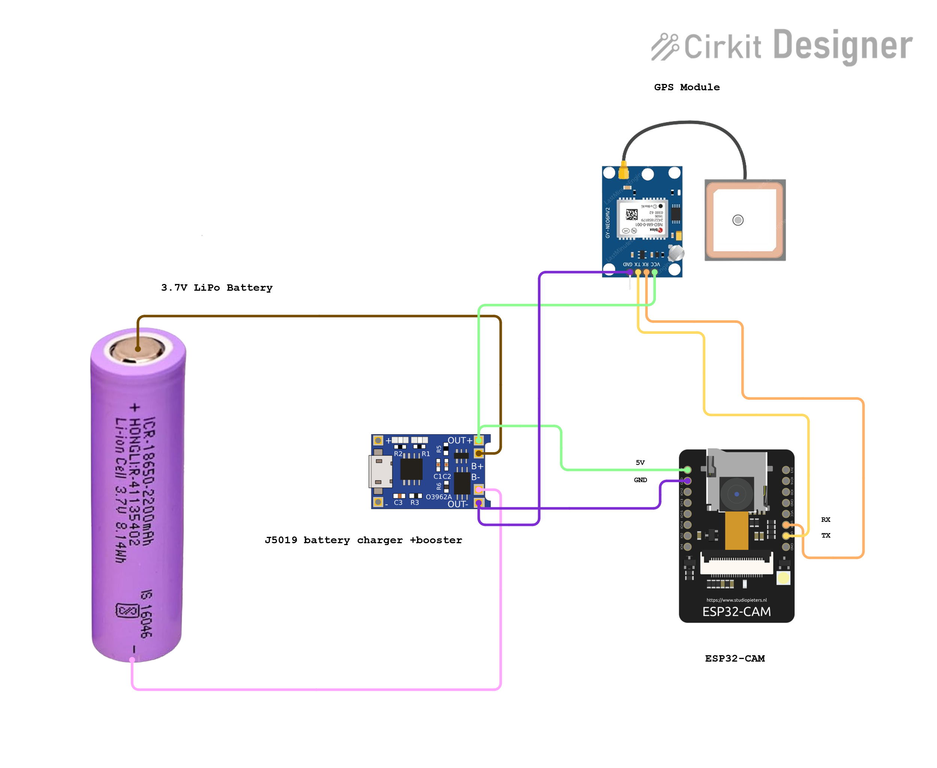
CIRCUIT DIAGRAM
Fig1.5 Circuit diagram

Slide 21
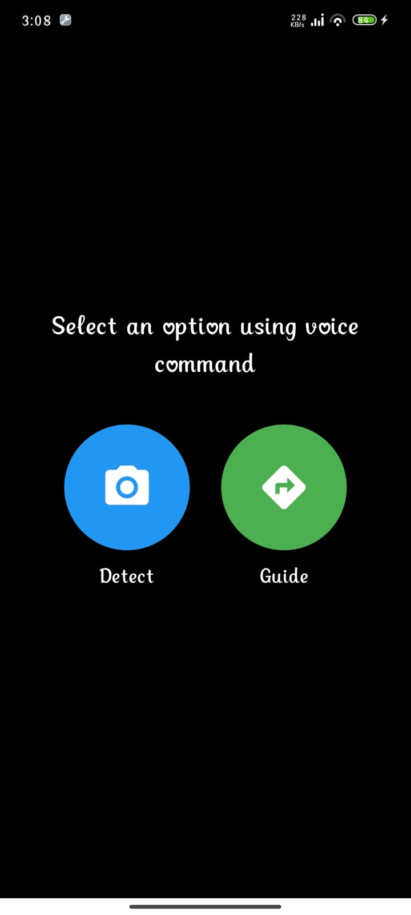
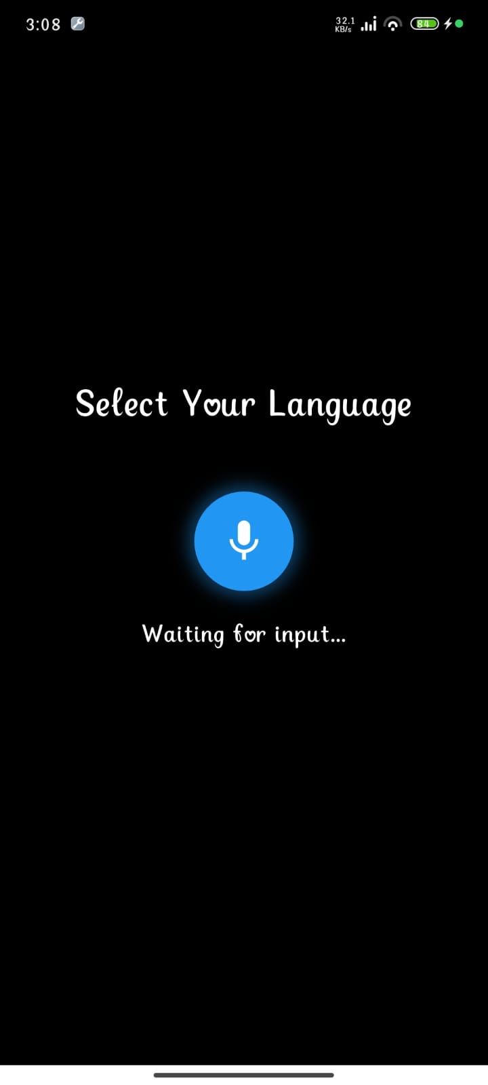
IMPLEMENTATION
Fig 1.6: Home screen
Fig 1.7:Language selection

Slide 22
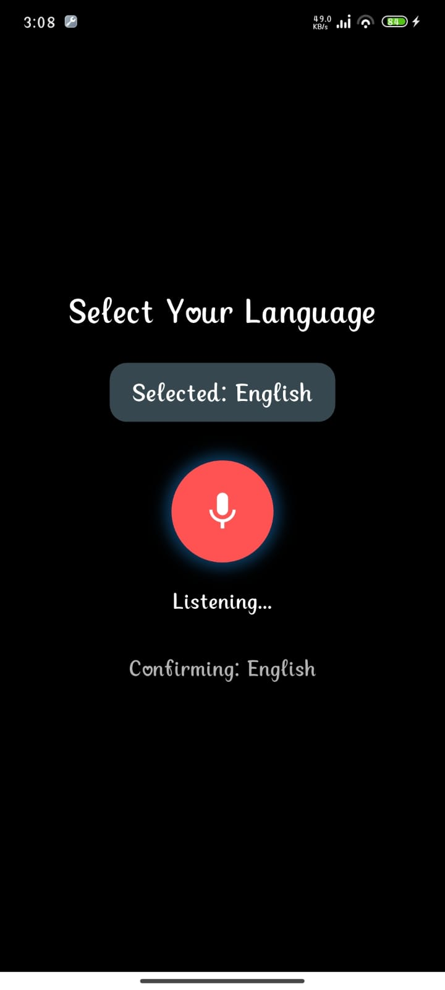
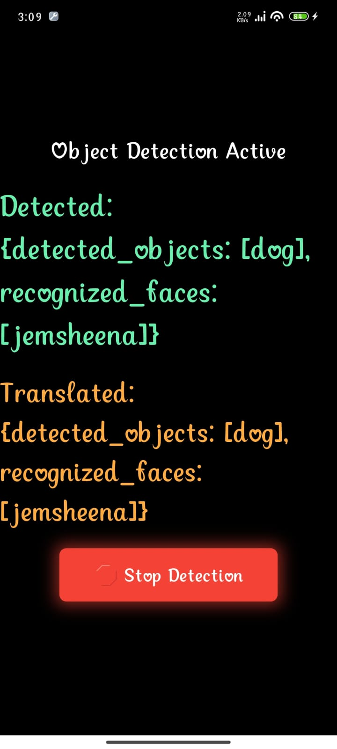
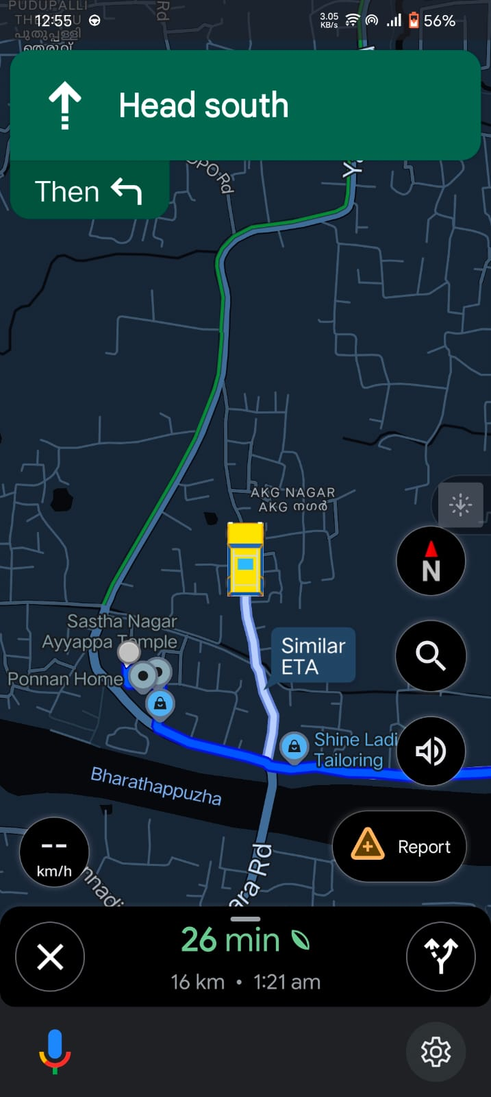
Fig 1.8:detecting user language
Fig 1.9:detection output
Fig 1.10: Navigation output

Slide 23
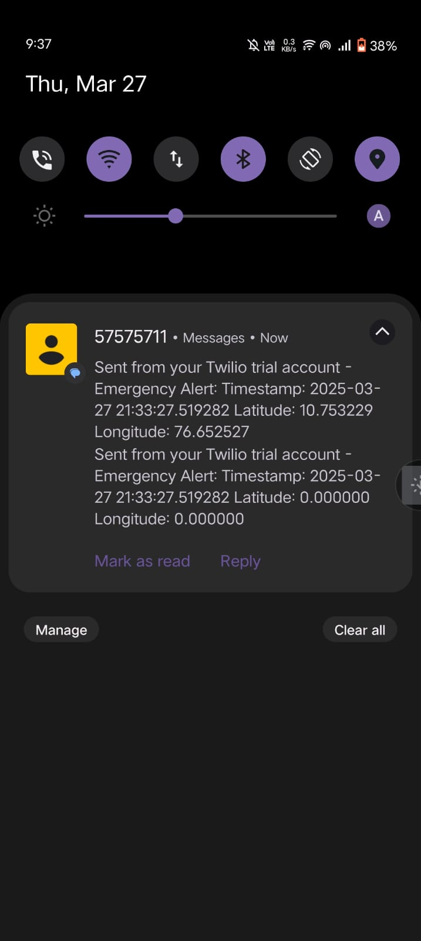
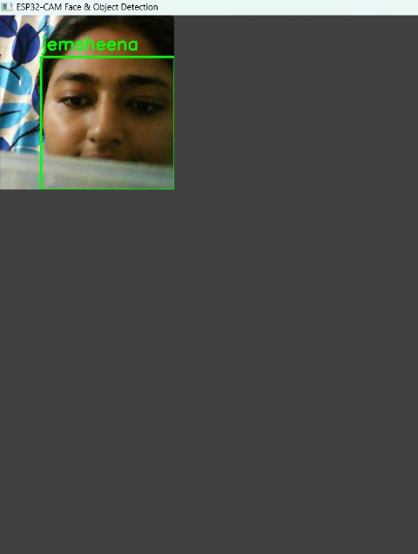
Fig 1.11:Emergency sms
Fig 1.11:face detection output

Slide 24



RESULTS
Object Detection & Face Recognition: The system successfully detected objects with an accuracy of 85% and recognized faces with an accuracy of 100% using YOLOv5 and face recognition library.
Multilingual Narration: Google TTS provided clear and fast narration with a response time of less than 1 second.
Navigation Assistance: The system accurately opened Google Maps for navigation 100% of the time when the user said “Navigate“.
Emergency Feature: Upon saying “Emergency" the system successfully placed a call to a predefined contact and sent an SMS with the user's GPS location with a success rate of 100%.

Slide 25
RESULTS
Hands-Free Interaction: Voice commands were recognized with an accuracy of 75%, ensuring a smooth and user-friendly experience.
Power Stability: The Li-ion battery with a booster provided continuous operation for up to 3-4 hours on a full charge.

Slide 26
RESULTS
GANTT CHART
18 Dec
03 Jan
17 Jan
27 Jan
07 Feb
17 Feb
27 Feb
07 Mar
17 Mar
27 Mar
Topic Selection
Literature Survey
Zeroth Presentation
System Architecture
Design
Hardware Setup
Software development
Integration &Testing
Documentation
13
19
5
8
11
29
19
23
79
Fig 1.10:Gantt chart

Slide 27
TASK ALLOCATION
TASK | MEMBERS
Data collection, Literature Survey | Fathima,Jemsheena,Thanzeera,Aparna
System Architecture | Fathima
Interaction Diagram | Thanzeera
Hardware Setup | Fathima,Jemsheena,Thanzeera,Aparna
Develop the Software | Fathima,Thanzeera,Jemsheena
Testing the System | Jemsheena
Documentation | Fathima,Jemsheena,Thanzeera,Aparna
Cost Analysis | Fathima,Jemsheena
Circuit Diagram | Jemsheena
Report Writing | Thanzeera
Table 1.1:Task Allocation

Slide 28
CONCLUSION
The Multilingual Smart Glasses provide a reliable assistive solution for visually impaired individuals in outdoor environments.
The system effectively integrates real-time object detection, face recognition, and multilingual narration to enhance accessibility.
Hands-free voice command ensures seamless and convenient user interaction.
Navigation assistance helps users reach their home location.
Emergency call and SMS with GPS feature ensures safety and quick response in critical situations.
The project demonstrated efficiency, and practicality, making it a valuable assistive technology for real-world use.

Slide 29
REFERENCES
Bai, J.; Liu, Z.; Lin, Y.; Li, Y.; Lian, S.; Liu, D. Wearable Travel Aid for Environment Perception and Navigation of Visually Impaired People. Electronics 2019, 8, 697.
Park, H.; Ou, S.; Lee, J. Implementation of Multi-Object Recognition System for the Blind. Intell. Autom. Soft Comput. 2021, 29, 247–258.
M. Mukhiddinov and J. Cho, "Smart Glass System using deep learning for the blind and visually impaired," Computer Vision and Pattern Recognition Techniques, 2021.
Joshi, R.C.; Yadav, S.; Dutta, M.K.; Travieso-Gonzalez, C.M. Efficient Multi-Object Detection and Smart Navigation Using Artificial Intelligence for Visually Impaired People. Entropy 2020, 22, 941.
S. K. Jarraya, W. S. Al-Shehri, and M. S. Hali, "Deep Multi-Layer Perceptron-Based Obstacle Classification Method From Partial Visual Information: Application to the Assistance of Visually Impaired People," IEEE Access, vol. 8, pp. 1-10, Jan. 2020

Slide 30
REFERENCES
Bai, J.; Liu, Z.; Lin, Y.; Li, Y.; Lian, S.; Liu, D. Wearable Travel Aid for Environment Perception and Navigation of Visually Impaired People. Electronics 2019, 8, 697.
Park, H.; Ou, S.; Lee, J. Implementation of Multi-Object Recognition System for the Blind. Intell. Autom. Soft Comput. 2021, 29, 247–258.
M. Mukhiddinov and J. Cho, "Smart Glass System using deep learning for the blind and visually impaired," Computer Vision and Pattern Recognition Techniques, 2021.
Joshi, R.C.; Yadav, S.; Dutta, M.K.; Travieso-Gonzalez, C.M. Efficient Multi-Object Detection and Smart Navigation Using Artificial Intelligence for Visually Impaired People. Entropy 2020, 22, 941.
S. K. Jarraya, W. S. Al-Shehri, and M. S. Hali, "Deep Multi-Layer Perceptron-Based Obstacle Classification Method From Partial Visual Information: Application to the Assistance of Visually Impaired People," IEEE Access, vol. 8, pp. 1-10, Jan. 2020

Slide 31
THANK YOU
AP PRE C IAT I O N

